Slide 1


Behaviour-Driven Development with StoryQ Liam McLennan Freelance Web Developer
liam.mclennan@gmail.com hackingon.net @liammclennan

Slide 2
Testing / Quality Assurance
The three ways to maintain release quality:
Automatic testing of all features ever implemented
Manual testing of all features ever implemented
Customer testing of features as they encounter them in production

Slide 3
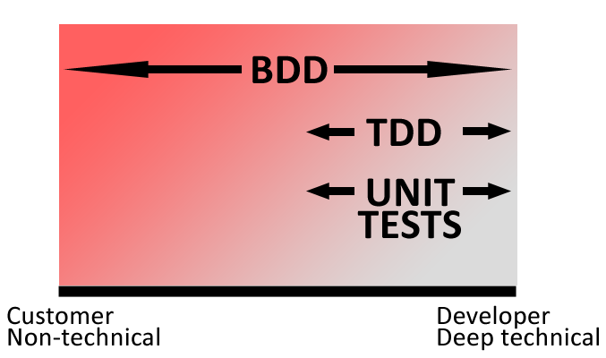
Some Automated Testing Strategies
Unit Tests / Test After
Test First (TDD)
Behaviour-Driven Development
Notes:
Unit test = Implementation verification
TDD = linking verification and design
BDD = linking verification and requirements

Slide 4

“Behaviour-driven development is about implementing an application by describing its behaviour from the perspective of its stakeholders”
Dan North

Slide 5
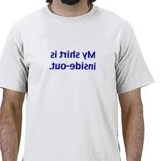
Features
Tests (specifications) are written outside-in, using the customer’s language and a simple test grammar.
Tests verify the intended behaviour, not the details of the implementation
The set of specifications becomes the authoritative system documentation.

Slide 6
Behaviour-Driven Development Workflow
Write a user story that delivers some value to the user
Define the behaviour using executable scenarios
Implement the behaviour until each scenario passes
Notes:
BDD is outside in.

Slide 7
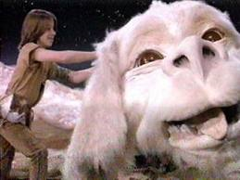
User Story
Story is Authenticate
In order to access secure resources
As an unauthenticated user
I want to sign in

Slide 8
Scenario
with scenario authenticate successfully
given a user with username “stevesmith”
and password “elvish”
when the user signs in using “stevesmith”/”elvish”
then they authenticate successfully

Slide 9
Scenario
with scenario authentication failure
given a user with username “stevesmith”
and password “elvish”
when the user signs in using “stevesmith”/”password”
then authentication fails

Slide 10
StoryQ
StoryQ is an internal DSL for writing, executing and documenting BDD specifications
http://storyq.codeplex.com/

Slide 11

Sign In
Story is Authenticate In order to access secure resources As an unauthenticated user I want to sign in
Feature authenticate = new Story("Authenticate") .InOrderTo("access secure resources") .AsA("unauthenticated user") .IWant("to sign in");
WE NEED THIS LATER

Slide 12

Create a Scenario
with scenario authenticate successfully given a user with username “stevesmith” and password “elvish” when the user signs in with “stevesmith”/”elvish” then they authenticate successfully
authenticate.WithScenario("authenticate successfully") .Given(AUserWithUsername, "stevesmith") .And(Password, "elvish") .When(TheUserSignsInWith,”stevesmith”,”elvish”) .Then(TheyAuthenticateSuccessfully) .Execute();
Notes:
Jump to StoryQ Converter
Write first specification
Show report

Slide 14
User Story
Story is Authenticate
In order to not access secure resources
As an unauthenticated user
I want to fail to sign in

Slide 15
Scenario
with scenario authenticate with correct credentials
given a user with username “stevesmith”
and password “elvish”
when the user signs in using “stevesmith”/”elvish”
Then authentication fails

Slide 16
Meet the competition
MSPec http://github.com/machine/machine.specifications
Specflow http://www.specflow.org/

Slide 17
Still Don’t Get BDD?
http://dannorth.net/introducing-bdd
http://www.code-magazine.com/article.aspx?quickid=0805061

